Slide 1
Instructions
Follow the learner instructions in the grey text boxes for each slide.
Delete the text box and instructions when complete.
Instructions for learner:
Action 1
Action 2
Action 3

Slide 2
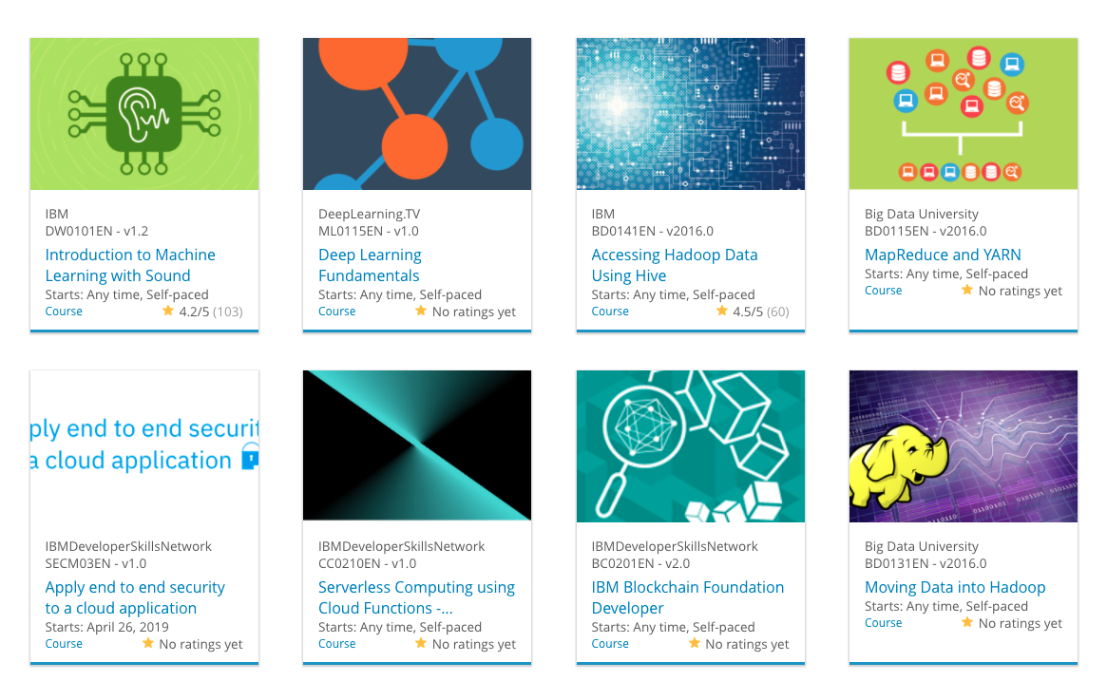

Instructions for learner:
- Delete the brackets and type your name and date on the title slide
Build a Personalized Online Course Recommender System with Machine Learning
Michael M
12/4/2022

Slide 3
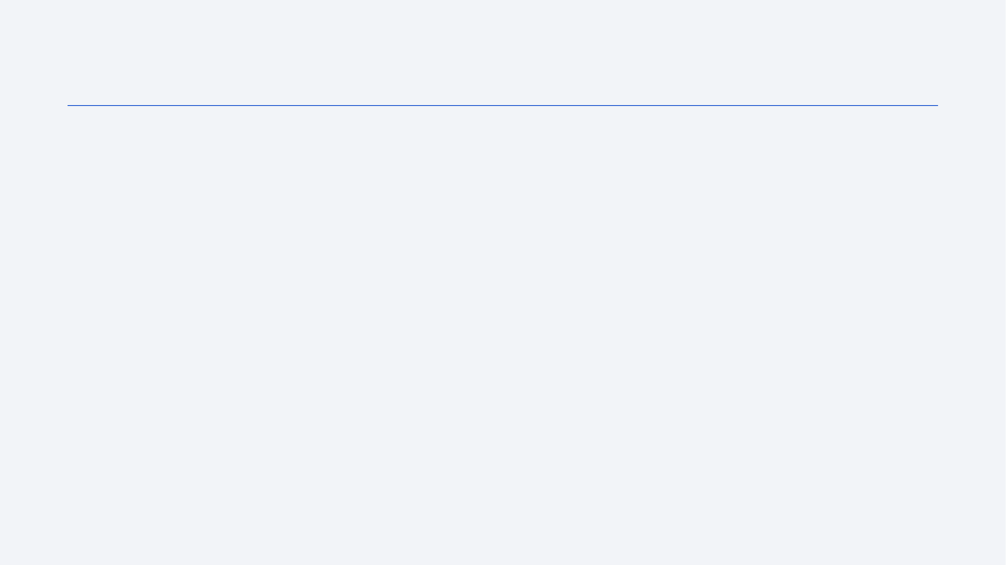
Outline
Introduction and Background
Exploratory Data Analysis
Content-based Recommender System using Unsupervised Learning
Collaborative-filtering based Recommender System using Supervised learning
Conclusion
Appendix

Slide 4
Introduction
Project background and context
Problem states and hypotheses
Instructions for learner:
- Describe the project background and context
- Describe the problem states and write the hypotheses

Slide 5
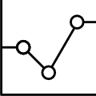
Exploratory Data Analysis

Slide 6
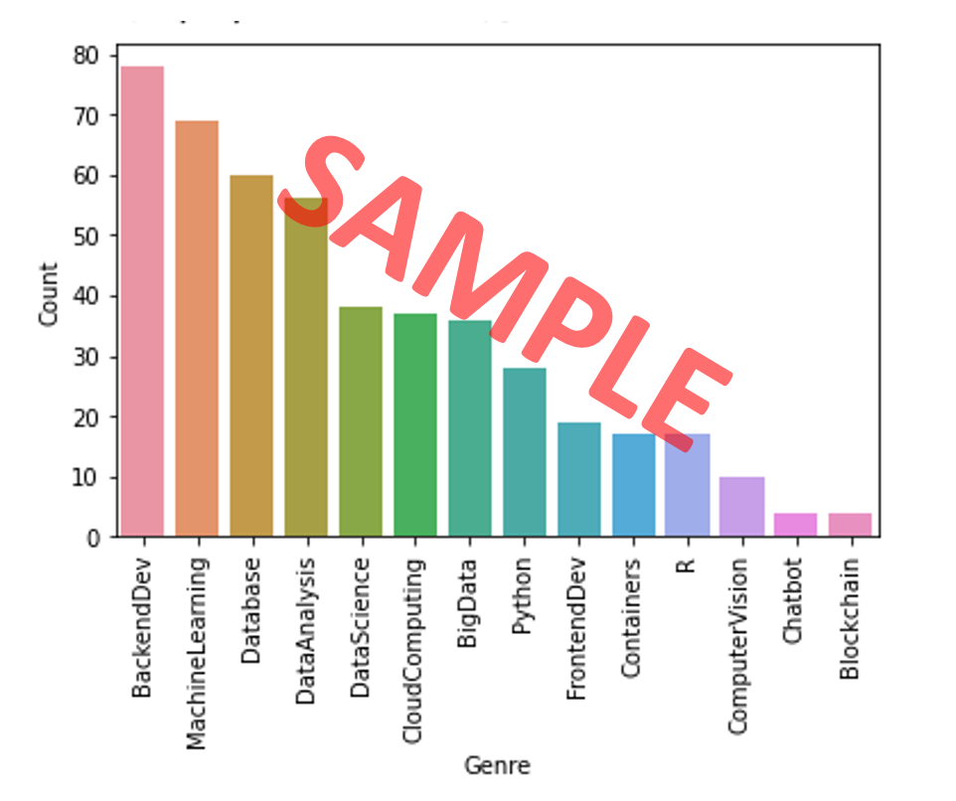
Course counts per genre
Place the barchart of course counts per genre here
Briefly explain the barchart in the slide notes (for peer-review purpose)
A sample bar chart may look like the following:

Slide 7
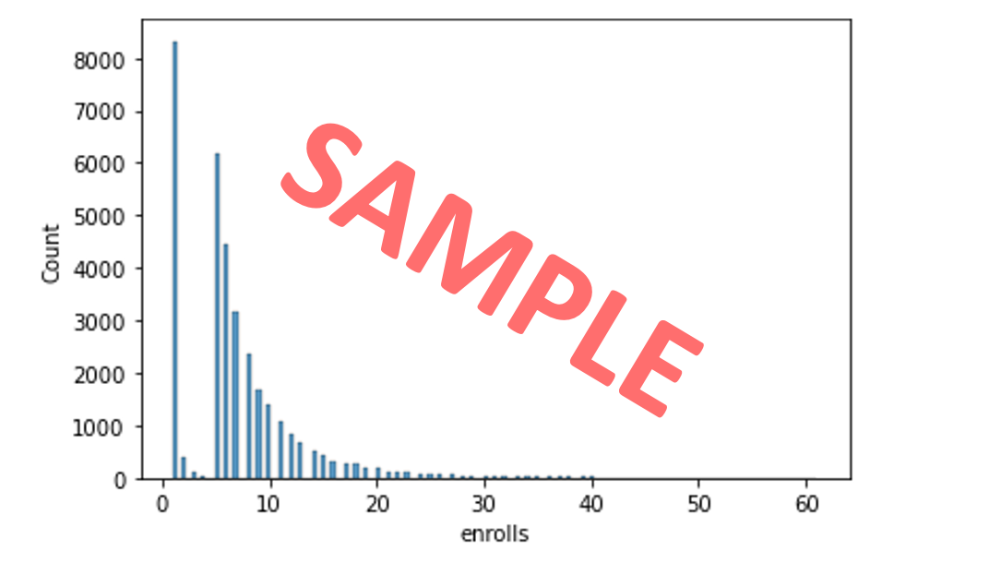
Course enrollment distribution
- Place the histogram showing the enrollment distributions here, e.g., it clearly shows how many users enrolled in just 1 course or how many enrolled 10 courses, etc.
- Briefly explain the histogram in the slide notes (for peer-review purpose)
- A sample histogram may look like the following:

Slide 8
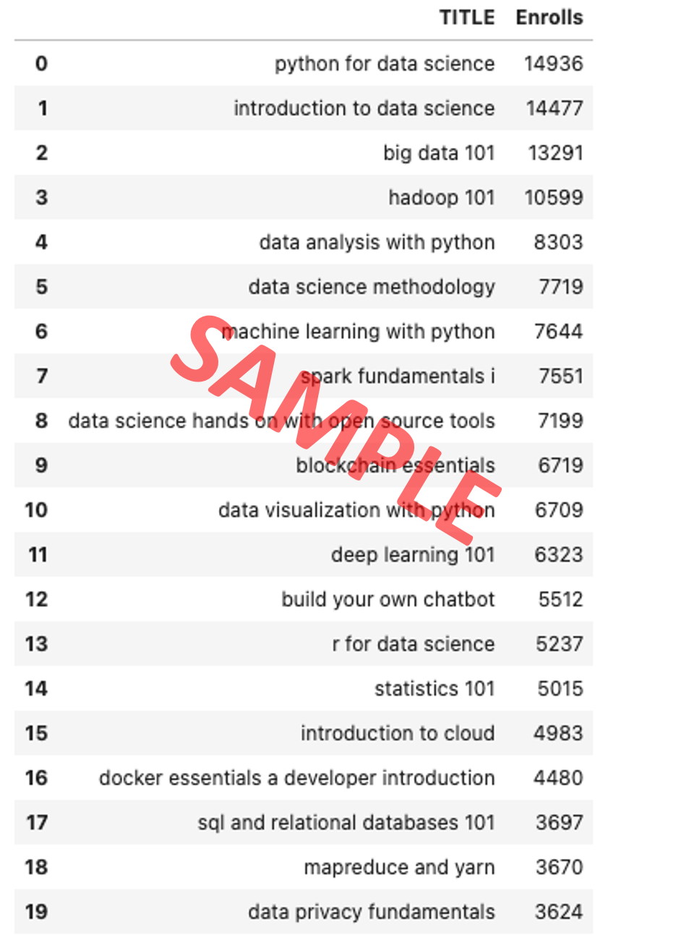
20 most popular courses
List the most popular 20 courses here
Briefly explain the course list in the slide notes (for peer-review purpose)

Slide 9
Word cloud of course titles
Place the word cloud (created from course titles) here
Briefly explain the word cloud in the slide note (for peer-review purpose)

Slide 10
Content-based Recommender System using Unsupervised Learning
Cluster2
Cluster1

Slide 11
Flowchart of content-based recommender system using user profile and course genres
- Plot a flowchart which should clearly illustrate how you implemented the content-based recommender system using user profile vectors and course genre vectors
Briefly explain the flowchart in the slide note
An example flowchart may look like the following:
Raw data
Data processing
Cleaned datasets
Feature engineering
Features

Slide 12
Evaluation results of user profile-based recommender system
Place your hyper-parameter settings, such as recommendation score or course similarity thresholds, etc.
Note: if you have tried multiple hyper-parameters, you may group and show all results in a grouped bar chart
On average, how many new/unseen courses have been recommended per user (in the test user dataset)
What are the most frequently recommended courses? Return the top-10 commonly recommended courses across all users

Slide 13
Flowchart of content-based recommender system using course similarity
- Plot a flowchart which should clearly illustrate how you implemented the course similarity based recommender system
- Briefly explain the flowchart in the slide note
An example flowchart may look like the following:
Raw data
Data processing
Cleaned datasets
Feature engineering
Features

Slide 14
Evaluation results of course similarity based recommender system
Your hyper-parameter settings, such as a score or similarity threshold
Note if you have tried multiple hyper-parameters, you may show your results in a grouped bar chart
On average, how many new/unseen courses have been recommended per user (in the test user dataset)
What are the most frequently recommended courses? Return the top-10 commonly recommended courses

Slide 15
Flowchart of clustering-based recommender system
Plot a flowchart which should clearly illustrate how you performed user profile clustering based recommender system
- Briefly explain the flowchart in the slide note
An example flowchart may look like the following:
Raw data
Data processing
Cleaned datasets
Feature engineering
Features

Slide 16
Evaluation results of clustering-based recommender system
Your hyper-parameter settings, such as a score or similarity threshold
Note if you have tried multiple hyper-parameters, you may show your results in a grouped bar chart
On average, how many new/unseen courses have been recommended per user (in the test user dataset)
What are the most frequently recommended courses? Return the top-10 commonly recommended courses

Slide 17
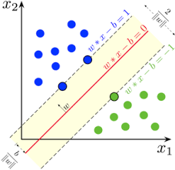
Collaborative-filtering Recommender System using Supervised Learning

Slide 18
Flowchart of KNN based recommender system
Plot a flowchart which should clearly illustrate how you performed KNN based recommender system using course enrollments history
- Briefly explain the flowchart in the slide note
An example flowchart may look like the following:
Raw data
Data processing
Cleaned datasets
Feature engineering
Features

Slide 19
Flowchart of NMF based recommender system
- Plot a flowchart which should clearly illustrate how you performed NMF based recommender system
- Briefly explain the flowchart in the slide note
An example flowchart may look like the following:
Raw data
Data processing
Cleaned datasets
Feature engineering
Features

Slide 20
Flowchart of Neural Network Embedding based recommender system
- Plot a flowchart which should clearly illustrate how you performed Neural Network Embedding based recommender system
- Briefly explain the flowchart in the slide note
An example flowchart may look like the following:
Raw data
Data processing
Cleaned datasets
Feature engineering
Features

Slide 21
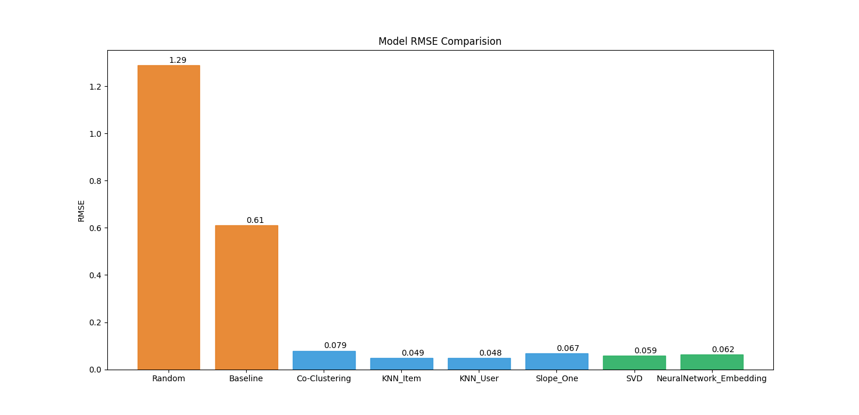
Compare the performance of collaborative-filtering models
Plot a barchart visualizing the performance metric (such as RMSE) of different collaborative-filtering models you have built so far
Briefly explain the barchart in the slide note
A sample barchart may look like the following

Slide 22
Optional: Build a course recommender system app with Streamlit
Streamlit app screenshot1
Streamlit app screenshot2
A published Streamlit App URL for a live demo

Slide 23
Conclusions
Point 1
Point 2
Point 3
Point 4
…

Slide 24
Appendix
Instructions for learner:
Include any relevant assets like a GitHub repo, key Python code snippets, charts, notebook outputs, or deployed Streamlit app URLs that you may have created during this project
Asset 1
Asset 2
Asset 3
Asset 4
…

